Slide 1
Lost Pet Mobile App Conceptual Design
Tyler Weppler
6/24/15

Slide 2
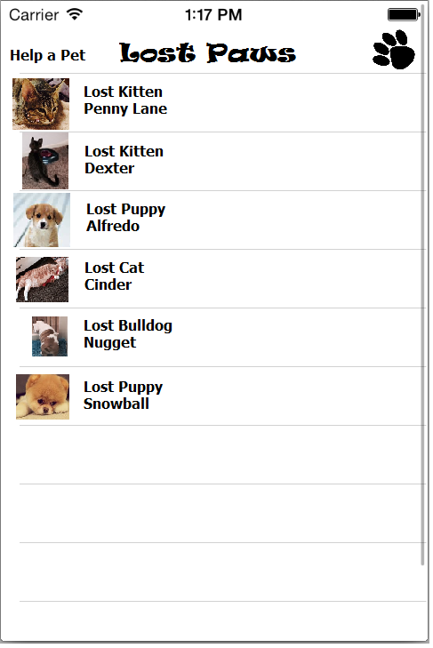
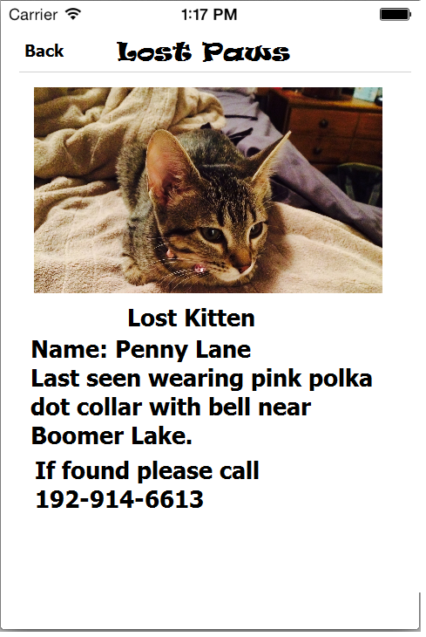

Slide 3
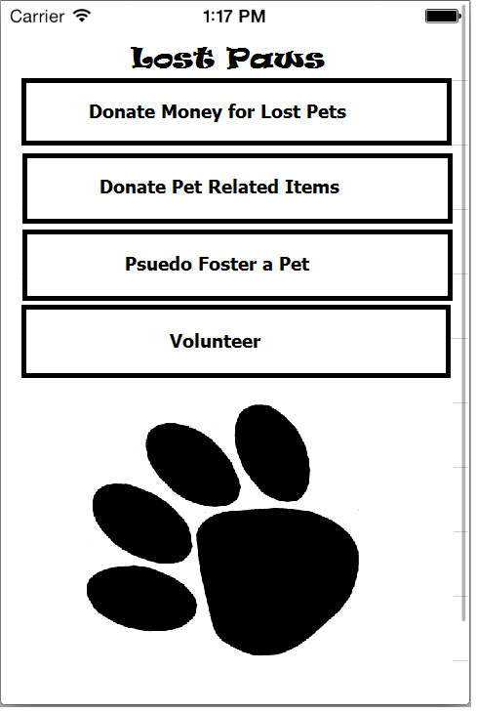

Slide 4
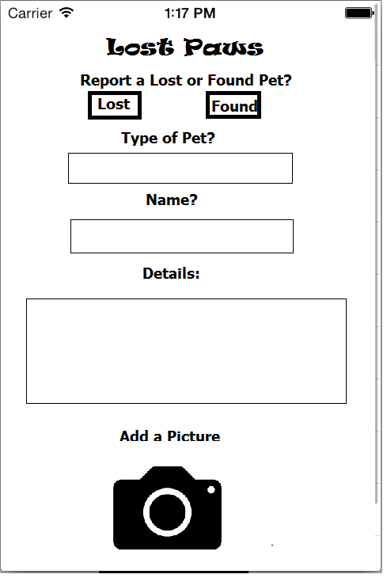

Slide 5



Things to Decide
Title
Furr Alert
Lost Paws
Other Suggestions
Color Scheme
Information for Psuedo Fostering and Volunteering
Additional pages/ideas
Fixes for current design idea

Slide 6
Lost Paws: In Progress
Tyler Weppler
8/27/15

Slide 7
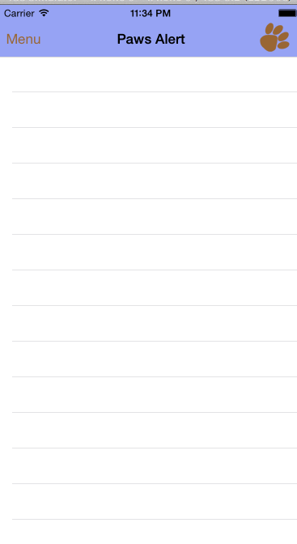
Search button or bar will allow
Easier searching for a pet
Cells will be populated by the app
Will call for info from webserver
Tabs will be used to separate
Lost versus Found pets

Slide 8
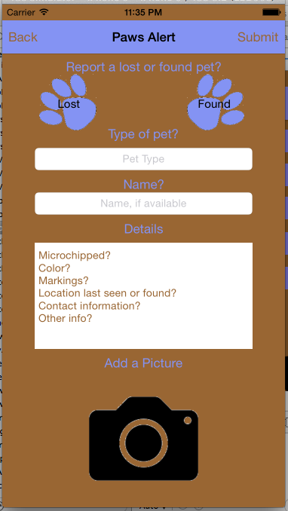
Button will open option for camera or photos
Image will change to chosen photo

Slide 9
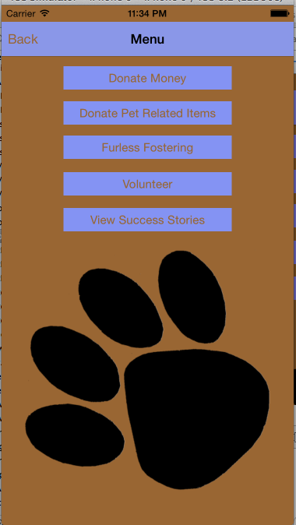
Gives user a list of items needed
Gives a shipping address for sending donations
Takes user to site to donate
User will have list of pets that need help and ways to help them
Asks user to pick between Tiny Paws, Humane Society, or Animal Welfare and goes to correct site
List of Stories about SAWC and animals that have been helped

